Slide 1

Getting Started with AWS Lambda Automation
Presented by Rich Morrow

Slide 2
Today’s class slides & code are available at: https://github.com/rich-morrow/autom8d-foundations

Slide 3
Schedule – Day 1
S1: Introduction & Lambda basics (40 mins)
S2: Python & the Boto3 Library (30 mins)
A1: ACTIVITY: Authoring Lambda function in AWS Cloud9 IDE (30 mins)
BREAK: 10 mins
S3: Automating with Lambda (60mins)
A2: ACTIVITY: Automating tag enforcement with Lambda and AWS Config (50 mins)
Q&A (10 mins)

Slide 4
Schedule – Day 2
S4: Authentication & Authorization (30 mins)
S5: EC2 & IaaS Automation (50 mins)
A3: ACTIVITY: Automating EC2 log processing and alerting (45 mins)
BREAK: 10 mins
S6: Operations Automation (40mins)
A4: ACTIVITY: Automating Trusted Advisor and EventBridge alerts to update CloudWatch dashboards (45 mins)
Course wrap up & next steps (10 mins)

Slide 5
Poll (single answer)
How much experience do you have with AWS Lambda?
Zero
Played with it a bit
Fairly proficient
Quite advanced

Slide 6
S1: Introduction to Lambda
Course outline & objectives
Value props of serverless
Lambda limits
Invocation methods (push, pull, direct invoke, scheduled action)
Basic anatomy of a Lambda function

Slide 7
Course Outline & Objectives
We WILL teach you:
Python, Lambda, AWS, Operations, Automation, GRC basics
Some AWS services. Namely: Cloud9, Lambda, AWS Config, IAM, EC2, TrustedAdvisor, EventBridge, CloudWatch, CloudTrail, S3, ELB, CloudFront, API Gateway, STS, VPC, Autoscaling, Systems Manager, Amazon Inspector, Secrets Manager.
We WILL NOT teach you:
In-depth Python, Lambda, AWS, Operations, Automation, or GRC.
In-depth AWS usage for ANY of these services, INCLUDING Lambda

Slide 8
Value props of Serverless
No “care and feeding” of infrastructure
Patching
Security
Monitoring
Networking
Scaling (Vertical -or- Horizontal)
Serverless architectures let you focus on your product, not your infrastructure.

Slide 9
Value Props: EC2 -vs- Containers -vs- Lambda
100 users
EC2 – “t2.nano”
20-30 sec
# of users served
10 users
Containers (ECS/EKS)
2-3 sec
< Sec
1 user
Serverless (Lambda)
response time
T₀ – Signal to Scale

Slide 10
Lambda Limitations & Limits
Can’t serve 3rd party apps (like Wordpress, MySQL, etc)
Both Containers & EC2 *can*, btw…
Lambda functions must execute in < 15mins
Though multiple Lambda functions can be tied together with Step Functions.
Lambda functions must consume < 10GB of memory
Invocation payload must be under 6MB
There are limitations around ports (like no SMTP) & low-level kernel calls.
Notes:
NOTE: AWS frequently changes limits around things like execution time & memory consumption. For the full list of current limits for AWS Lambda, check https://docs.aws.amazon.com/lambda/latest/dg/gettingstarted-limits.html

Slide 11






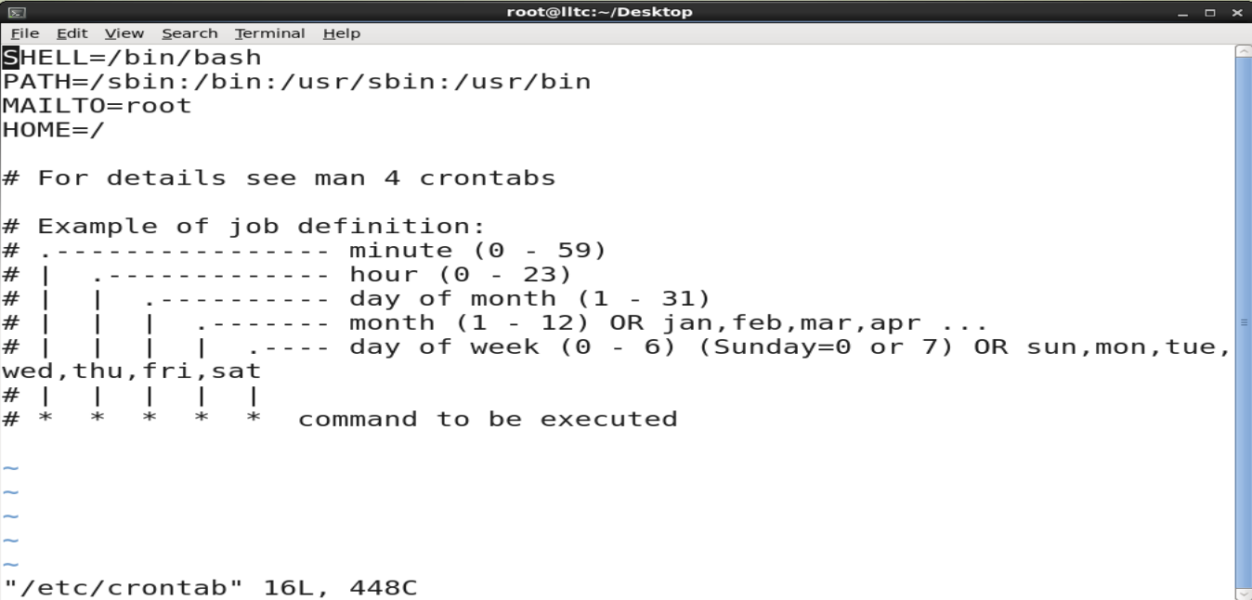
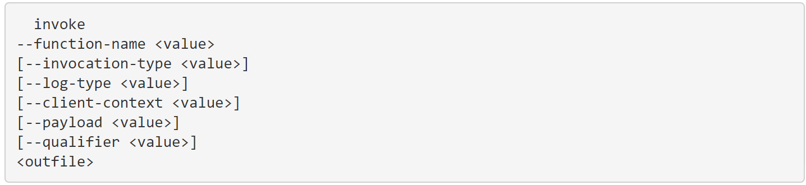
Lambda Invocation Methods
1) PUSH
“Hey Lambda, here’s some data”
2)PULL/POLL
“Hey <Svc X>, Have any data for me?”
Event Notifications
S3
SQS
SQS: GetRecords API Call
Lambda trigger
Lambda
Lambda
Lambda Subscription
SNS
DynamoDB Streams
3) SCHEDULED ACTION
4) DIRECT INVOCATION
-OR-
Can be synchronous or asynchronous
https://docs.aws.amazon.com/cli/latest/reference/lambda/invoke.html
Native Reoccuring
Raw crontab
DynamoDB Streams

Slide 12
Shift left in development?

Slide 13
Anatomy of a Lambda Function
def lambda_handler(event, context):
message = 'Hello {} {}!'.format(event['first_name'], event['last_name’])
return {
'message' : message
}
event: contains event data, like html form data. Example:
{ "first_name": "John", "last_name": "Smith" }
Would Return:
{ "message": "Hello John Smith!" }
context: provides info about the invocation, function & execution environment. Example:
print("Lambda function ARN:", context.invoked_function_arn)
print("CloudWatch log stream name:", context.log_stream_name)
print("CloudWatch log group name:", context.log_group_name)
print("Lambda Request ID:", context.aws_request_id)
print("Lambda function memory limits in MB:", context.memory_limit_in_mb)
# We have added a 1 second delay so you can see the time remaining in get_remaining_time_in_millis. time.sleep(1)
print("Lambda time remaining in MS:", context.get_remaining_time_in_millis())
Handler: the entry point where you function starts processing.
Note on naming: Handler name is derived from:
The name of the file in which the handler function is located
The name of the Python handler function.
Default name in the console is just “lambda_handler”.
IMPORTANT: Code inside than handler is executed on each function call, code outside the handler is executed only on “cold starts” (Luckily for us, Python and Node.js are the fastest to start)
Notes:
Python handler examples from AWS Documentation at https://docs.aws.amazon.com/lambda/latest/dg/python-handler.html
Context examples from AWS Documentation at https://docs.aws.amazon.com/lambda/latest/dg/python-context.html
Details on cold starts: https://dashbird.io/knowledge-base/aws-lambda/cold-starts/

Slide 14
Poll (single answer)
How much experience do you have with AWS?
Zero
A few months
A few years
Extensive (been a main function of my job for years)

Slide 15
S2: Python & the Boto3 Library
Python’s suitability for scripting, AWS, Lambda
Python basics
Advantages of Boto3
Review of Lambda basics

Slide 16
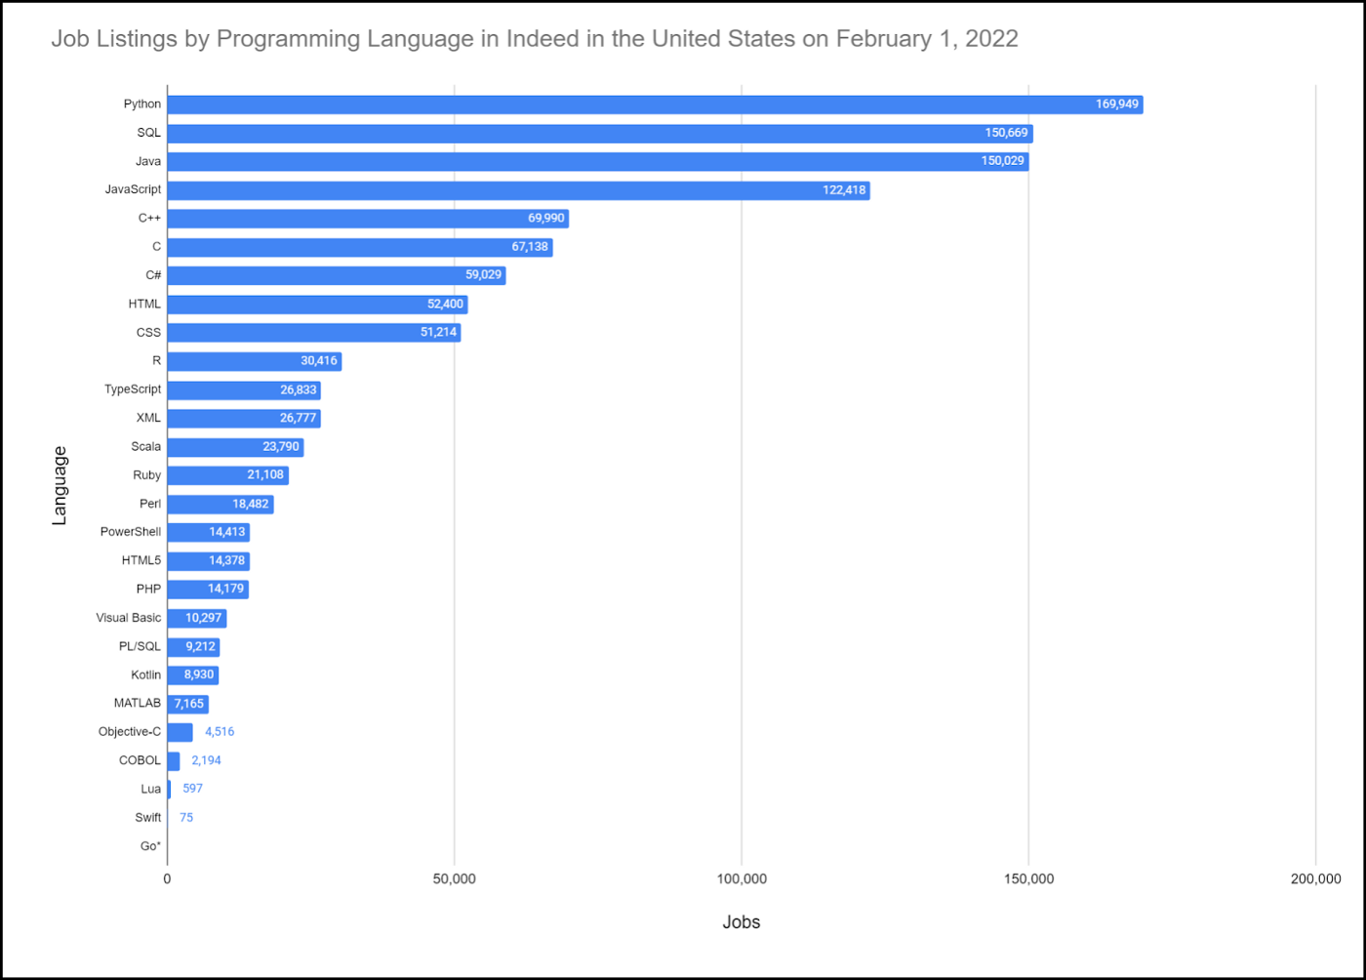

Python’s suitability for scripting, AWS, Lambda
Scripting:
Syntactically terse.
Versatile (esp in Machine Learning & Data Science w/tools like Pandas, NumPy and Jupyter Notebooks).
It’s Popular! Lots of sysadmins already use it!
AWS:
Lots of code examples.
Lots of native support in services like CodeGuru, CDK, SDK, etc.
Lambda:
Fastest cold start time of any Lambda languages.
Lots of docs, tutorials, quickstarts in Python.

Slide 17
Python basics
Basic data types: numbers (floating point, complex, and unlimited-length long integers), strings (both ASCII and Unicode), lists, and dictionaries.
Supports object-oriented programming with classes and multiple inheritances.
Supports raising and catching exceptions (cleaner error handling).
Data types are strongly and dynamically typed. Mixing incompatible types (e.g. attempting to add a string and a number) causes an exception to be raised, so errors are caught sooner.
Automatic memory management (garbage collection)
Uses PEP code style rules (indentation sensitive, 4 spaces per level)
Notes:
Python beginners guide at: https://wiki.python.org/moin/BeginnersGuide/Overview
PEP 8 Style Guide: https://wiki.python.org/moin/BeginnersGuide/Overview

Slide 18
A basic Python program
# NOTE: It’s common to import external libraries. Imports always go at top of the file, but this program is basic - we don’t have any
# Functions are the core of what we do in Python, let’s define two…
def add(num1, num2):
return num1 + num2
def subtract(num1, num2):
return num1 - num2
# Send some txt to stdout to instruct the user what to do
print("Please select operation -\n" \
"1. Add\n" \
"2. Subtract\n")
# Accept input from the user
select = int(input("Select operations form 1, 2:"))
# Do sanitization of input data (convert to integer)
number_1 = int(input("Enter first number: "))
number_2 = int(input("Enter second number: "))
# perform some basic logic to add, subtract or return error
if select == 1:
print(number_1, "+", number_2, "=",
add(number_1, number_2))
elif select == 2:
print(number_1, "-", number_2, "=",
subtract(number_1, number_2))
else:
print("Invalid input")
Recommended: Python Cheat Sheets

Slide 19
Boto3 Library
Basically, the AWS SDK for Python
Allows for CRUD, operating and maintaining of AWS services
Provides ‘waiters’ which poll for resource status changes
Aggressively maintained by AWS
Excellent documentation
Two options for usage:
Client API (low level 1:1 mapping of method:underlying API, when control is needed)
Resource API (high level, provides more developer productivity)

Slide 20
Boto3 examples
#upload file to S3 (resource API automatically determines when to do multi-part!)
import boto3
s3 = boto3.resource('s3')
s3.meta.client.upload_file('source_file_name.html', 'my.bucket.com', 'aws_file_name.html', ExtraArgs={'ContentType': "application/json", 'ACL': "public-read"} )
#step through all EC2s, restart any stopped (resource API allows iteration over collections!)
for i in ec2.instances.all():
if i.state['Name'] == 'stopped’:
i.start()
#filter cloudwatch event rule, listing Alarms (client API allows override of Region)
import boto3
AWS_REGION = "us-west-2“
client = boto3.client('events', region_name=AWS_REGION)
response = cloudwatch.list_rules(
NamePrefix='Alarm’
)
print(response)

Slide 21
More Boto3 examples
#count visits to ‘some-web-page’ over Q1. This would assume some previously created custom CloudWatch metric ‘Number of visits’ in the Namespace ‘Web Traffic’
import boto3
from datetime import datetime
AWS_REGION = "us-west-2“
client = boto3.client('cloudwatch', region_name=AWS_REGION)
response = client.get_metric_data(
MetricDataQueries=[
{
'Id': 'identifier’,
'MetricStat’: {
'Metric': { 'Namespace': 'Web Traffic’,
'MetricName': 'Number of visits’,
'Dimensions’: [
{
'Name': 'page’,
'Value': ‘some-web-page.html’
}
]
},
'Period': 300,
'Stat': 'Sum’,
'Unit': 'Count’
}
},
],
StartTime=datetime(2022, 1, 1),
EndTime=datetime(2022, 3, 31)
)
print(response)
print(sum(response['MetricDataResults'][0]['Values']))

Slide 22
Review of Lambda Basics
Lambda can work with other languages than Python!
Can use multiple editors (we’ll primarily use AWS native Cloud9 IDE)
Can (and should) use Layers to include external packages
Reusable
Allow centralized, common control over packages
Reduce deployment package size
All code & dependencies contained in a zipfile
State Machines (combinding multiple Lambdas & other svcs) can be constructed from AWS Step Functions

Slide 23
Activity 1: Real world Lambda function in Cloud9 IDE
Authoring a Lambda function
Testing
Running in the Cloud9 IDE
Q&A

Slide 24
Break! (10 mins)

Slide 25
Poll (single answer)
How much experience do you have with automation (bash, python, powershell, etc)?
Zero
A few months
A few years
Extensive (it’s a main function of my job)

Slide 26
S3: Automating with Lambda
Advantages of automation
Using Tags effectively
Use cases in CI/CD, security, governance, regulation, compliance, operations
High-level walkthrough of 12-15 innovative, practical use cases for Lambda automation across those domains
How to identify opportunities for automation in your unique role

Slide 27
Advantages of automation
Your time is precious!
You’re not good at repetitive tasks (but your computer sure is!)
Version Control
Audit Trails
Repeatable, Reliable, Reusable, Scalable, Consistent
NOTE: Lambda is only ONE of the tools to automate…
Systems Manager Automation Playbooks, CloudFormation are other tools. And many services have native automation hooks

Slide 28
Tags in AWS
Tags are just “key : value” pairs. Like: “owner : me@email.com” that we assign to resources (like EC2).
They serve 4 main purposes:
Access Control: Tag an EC2 with “env = prod” & then set Developers group to DENY all actions on “env != dev”.
Filtering: Tag your Lambdas with “owner = me@email.com” & then quickly find your handful of functions in the console.
Billing: Tag your resources with “cost-center = application-xyz” & then roll up total AWS costs for just your app.
Automation: Tag an EBS disk with “grc-level = pci-1” & then set up automation to ensure all these tagged disks are encrypted.

Slide 29
Using Tags effectively
AWS allots 50 tags / resource
Use 10-15 for company wide purposes (billing, access control, escalations to resource owner, etc)
Use remainder for application or department-specific needs
Creating (and enforcing) a tag topology is job #1 in AWS!!!
Enforcement can happen at resource creation time -AND- on an ongoing basis.

Slide 30
Lambda Security Automation
DevSecOps (sniff for secrets, run SCA, enforce policies in SGs, WAF, ELBs, VPCs, etc)
Enforce security Tag policies (encryption at rest/wire, “env=dev|test|prod”, VPC, SG req’d tags, etc)
AWS Foundational Security Best Practices controls
Security-related Lambda scripts from the AWS Security Blog
Notes:
SCA: Static Code Analysis
SG: Security Group
WAF: Web Application Firewall

Slide 31



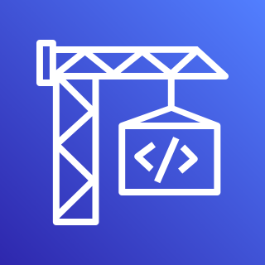
DevSecOps
1.
2.
3.
Developers
AWS CodeCommit
Lambda Security
Checks
AWS CodeBuild
Code Commited
Secrets (AK/SK, etc) sniff
Static Code Analysis
Look up Config (possibly tag-based)
Enforce WAF rules
Enforce SG policies
Enforce ELB Security
Enforce VPC setup
…and more!
Continue Build, Test, Deploy…

Slide 32
Lambda & Security Hub Integration!
Remediate Security Hub findings
Security, Orchestration, Automation, Response (SOAR) Workflows
Dynamically update WAF/SG/DNS policies via Firewall Manager Automations
Alert / remediate Access Analyzer or CloudTrail issues
EC2 telemetry via Amazon Inspector
Trusted Advisor recommended best practices
AWS Security Hub Automated Response and Remediation

Slide 33
Lambda GRC Automation 1
Combine with AWS Config Rules to alert / remediate resource misconfigurations
Publicly exposed S3 resources (via Access Analyzer)
Mistakenly open SGs
Service-level logging disabled / misconfigured

Slide 34
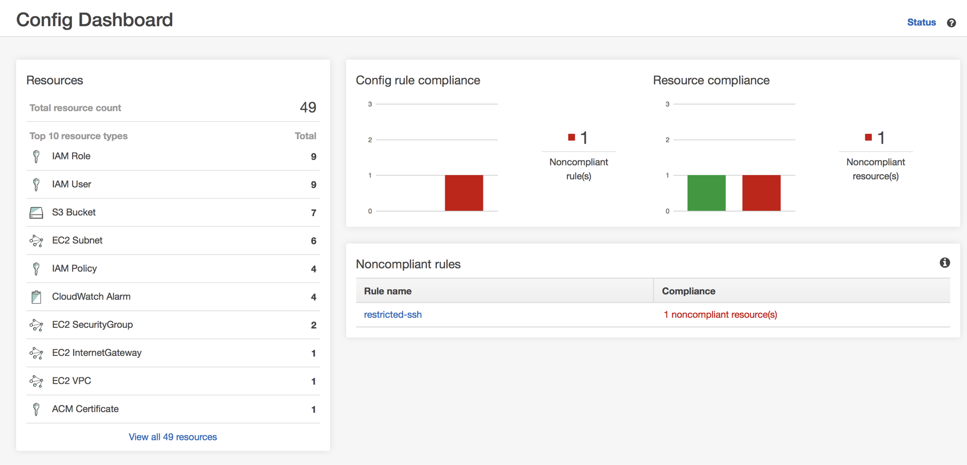
AWS Config dashboard compliance

Slide 35
Lambda GRC Automation 2
Logfile processing or validation (CloudTrail, S3/ELB access logs, other audit logs)
EC2 instance compromise (via GuardDuty and/or Inspector)
RDP / SSH brute force
Bitcoin activity
Unusual activity (instance launch, remote server access, etc)
Unauthorized, unpatched software or users on instance
AWS Compliance Center!
NOTE: Make sure Lambda passes GRC requirements!

Slide 36
Lambda Operations Automation
Identify then downscale or turn off resources (EC2, ECR, Redshift, etc) when unneeded/unused
Automate CI/CD pipelines
IoT device management
Alert, remediate operational issues
Resource scarcity (EC2 memory, CPU, etc)
Security issues (via Security Hub)
Event stream processing (sourced from EventBridge, Kafka, etc)

Slide 37
When to Automate?
Any time you’ve done something a 2nd, 3rd time.
When time criticality (GRC, security exposure, resource scarcity) is of utmost importance.
Downsizing, shutting off unneeded or unused resources.
DevOps toolchains, CI/CD pipelines.
Metrics & monitoring alerts & remediations.
Tag enforcement!

Slide 38
Break! (10 mins)

Slide 39
Activity 2: Automating tag enforcement with AWS Lambda and AWS Config
Tag configuration
Basics of AWS Config
AWS Config parameterization of tagging
AWS Config enforcement of tagging
Validation of tagging enforcement

Slide 40

EOD Q&A

Slide 41
Schedule – Day 2
S4: Authentication & Authorization (30 mins)
S5: EC2 & IaaS Automation (50 mins)
A3: ACTIVITY: Automating EC2 log processing and alerting (45 mins)
BREAK: 10 mins
S6: Operations Automation (40mins)
A4: ACTIVITY: Automating Trusted Advisor and EventBridge alerts to update CloudWatch dashboards (45 mins)
Course wrap up & next steps (10 mins)

Slide 42
Poll (single answer)
How much experience do you have with AWS IAM?
Zero
A few months (can read a basic PD)
A few years (can write advanced PD)
Extensive (it’s a main function of my job)

Slide 43
S4: Authentication & Authorization
Review of IAM.
Review of Logging services (CloudTrail, S3 Logs, ELB Logs, CloudFront Logs, API Gateway Logs).
Utilizing STS Roles.

Slide 44






Review of IAM
have
AK/SK
(long term)
STS
(short term)
User
App
Role
Credentials
have
Principals
A Principal accesses a Resource (via SDK, CLI, Console or REST API)
Credentials are validated
Permissions (both principal and/or Resource) are checked
Access is granted or denied
CloudTrail (if enabled) logs outcome
Policy Document
Permissions
Notes:
NOTE: This is GREATLY simplified! Policy evaluation logic is a whole lot more complex in AWS. Here’s the skinny: https://docs.aws.amazon.com/IAM/latest/UserGuide/reference_policies_evaluation-logic.html

Slide 45
Policy Document examples
Allow all S3, DDB API calls for 2022 Q1
{
"Statement": [
{
"Effect": "Allow",
"Action": “s3:*,dynamodb:*",
"Resource": "*",
"Condition": {
"DateGreaterThan": {"aws:CurrentTime": "2022-01-01T00:00:00Z"},
"DateLessThan": {"aws:CurrentTime": "2022-03-31T23:59:59Z"}
}
}
]
}
AWS Policy Generator
REQUIRED
OPTIONAL
Allow attach/detach of EBS volume to specific EC2
{
"Statement": [
{
"Effect": "Allow",
"Action": [“ec2:AttachVolume", “ec2:DetachVolume“],
"Resource": [ "arn:aws:ec2:*:*:volume/*", "arn:aws:ec2:*:*:instance/*" ],
"Condition": {
"ArnEquals": {"ec2:SourceInstanceARN": "arn:aws:ec2:*:*:instance/instance-id"}
}
}
]
}

Slide 46
IAM permissions for Lambda
Event Notifications
S3
Requires Lambda invoke permissions
Lambda
DDB:PutItem(x)
“upstream svc invoking lambda”
DynamoDB
Requires Lambda execution role
Lambda Resource-side Policy:
“lambda executing API call on downstream svc”
"Statement": [
{
"Effect": "Allow",
"Principal": { "Service": "s3.amazonaws.com" },
"Action": "lambda:InvokeFunction",
"Resource": "arn:aws:lambda:us-east-2:123456789012:function:my-function",
"Condition": {
"StringEquals": { "AWS:SourceAccount": "123456789012" },
"ArnLike": { "AWS:SourceArn": "arn:aws:s3:::my-bucket" }
}
}
]
Roles have 2 parts:
Role with PD (permission)
Trust relationship to allow principal (Lambda) to assume role
Notes:
For more info on Lambda execution roles, see https://docs.aws.amazon.com/lambda/latest/dg/lambda-intro-execution-role.html

Slide 47
Lambda Execution role for DDB
Role with PD (permission)
Trust relationship (trust-policy.json)
{
"Version": "2012-10-17",
"Statement": [
{
"Effect": "Allow",
"Action": [
"dynamodb:PutItem",
"logs:CreateLogGroup",
"logs:CreateLogStream",
"logs:PutLogEvents",
],
"Resource": "*"
}
]
}
{
"Version": "2012-10-17",
"Statement": [
{
"Effect": "Allow",
"Principal": {
"Service": "lambda.amazonaws.com“
},
"Action": "sts:AssumeRole“
}
]
}
aws iam create-role --role-name lambda-ex \n
--assume-role-policy-document file://trust-policy.json
aws iam attach-role-policy --role-name lambda-ex --policy-arn arn:aws:iam::aws:policy/service-role/NameOfLambdaRoleYouCreatedInStep1

Slide 48
Logging Services in AWS
CloudTrail: Logs all GA’d service API calls
Access Logs:
S3
ELB (Application and Network Load Balancers only)
CloudFront CDN
API Gateway
KMS
NOTE: ALL of these logs must be turned on!

Slide 49
STS Roles in IAM
User-configurable (15m – 36h) forced expiration (temporary access ONLY)
Behind Federated access (internal users – SAML, SSO, AD/LDAP), Amazon Cognito (end users), Roles (esp EC2, ECS/EKS [svc and task], Lambda), S3/CloudFront short-term signed URLs & other time-limited AWS access.
Preferred over long term AK/SK credentials
More secure
Roles need no hardcoded credentials

Slide 50
Poll (single answer)
How comfortable are you with EC2?
I can spell it ☺
Basic proficiency (basic EBS, SG, ENI, VPC config)
Advanced proficiency (advanced networking, security)
Extensive (it’s a main function of my job)

Slide 51
S5: EC2 & IaaS Automation
Challenges of EC2 environment (telemetry on the instance, limitations of AWS-level visibility into server internals).
Review of EC2-related services (VPC, Autoscaling, EBS, Systems Manager, Inspector, Secrets Manager, CloudWatch, EventBridge).
Review of EC2 and Autoscaling hooks.
Review of EC2 Lab.

Slide 52
Challenges of EC2
No native AWS API access to internals of server!
AWS Systems Manager (SSM) can help.
Limited CloudWatch visibility into internal metrics (no RAM utilization metric, for example).
Unique security concerns:
Remote access via SSH / RDP (probably biggest attack vector).
Ongoing patching (of OS, packages) required.
Need permissions to interact w/other AWS services.
It’s “true” IaaS. Wait… what’s IaaS?

Slide 53
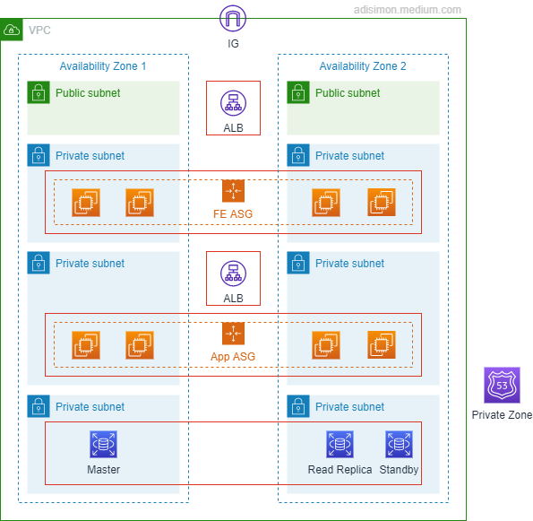
IaaS -vs- PaaS -vs- SaaS
Software aaS – think Office 365, Salesforce G’Apps…
Control Convenience
“non-tecchies point and click to configure app”
AWS Web Console!
Platform aaS – GCP & Azure started here
“Point and click custom app deployment & mgmt”
AWS: Elastic Beanstalk
Infrastructure aaS – 95% of what AWS offers is this!
“lego building blocks” -- You gotta know intricacies of each piece
But some folks say only “VMs” (AWS: EC2) are IaaS… I disagree, BTW…

Slide 54







EC2 Internals
Security group
“point & click firewall”
CW Agent
AWS Systems Manager
Amazon CloudWatch
SSM Agent
NAT gateway
Inspector
Elastic network interface
EC2 Instance
H/W ½ (instance type)
S/W ½ (Amazon Machine Image) or “AMI”
May have local (ephemeral) disk
At least one NIC card (ENI)
EBS Volume
Elastic IP address
Amazon Inspector

Slide 55



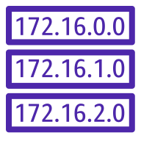





EC2 Ecosystem
Internet
VPC
Internet gateway
Availability Zone 1
Availability Zone 2
NAT gateway
NAT gateway
Public subnet
Public subnet
Route table
Application Load Balancer
Route table
NAT Gateway
NAT Gateway
Auto Scaling group
Private subnet
Private subnet
Route table
Route table
EC2 Instance
EC2 Instance

Slide 56









AWS Systems Manager
Automation
Documents
Patch Manager
Parameter Store
Run Command
Inventory
Maintenance Windows
State Manager
…And LOTS More
OpsCenter

Slide 57
Amazon Inspector
“Automated , continual vulnerability management at scale”
Agent-based (white box) and agent-less (black box)
Works with EC2, Containers
Calculates contextualized “risk score” based on CVE info
Has own console, and Security Hub integration
Can be used with EventBridge to automatically generate tickets and start remediation workflows
Notes:
https://aws.amazon.com/inspector/?nc=sn&loc=0

Slide 58


AWS Secrets Manager
“Rotate, manage, retrieve DB creds, API keys and other secrets”
Very useful for database credentials
Secrets Manager
Creds Rotation
App
EC2/OP svr
Database
Notes:
AWS Security Blog on using lambda with Secrets Manager & credentials rotation: https://aws.amazon.com/blogs/security/how-to-securely-provide-database-credentials-to-lambda-functions-by-using-aws-secrets-manager/

Slide 59

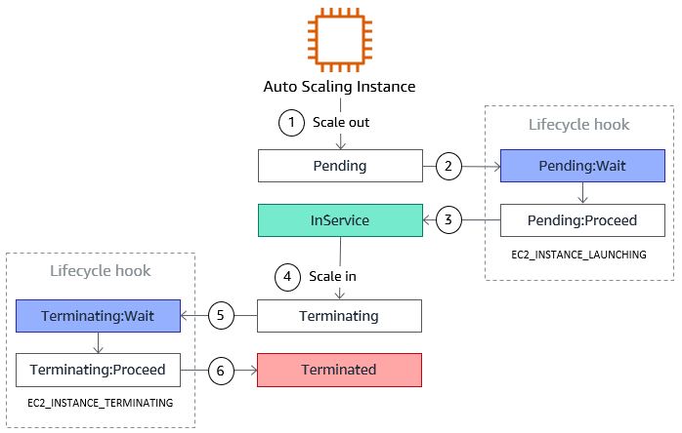
EC2 Auto Scaling Lifecycle Hooks
Used for:
Bootstrapping
Notifications
Cleanup

Slide 60
Activity 3: Automating EC2 log processing and alerting
Configuration of EC2 logs and CloudWatch agent
Coding Lambda log processor
Route particular log entries to Lambda with a CloudWatch Subscription Filter
Reviewing log processing events & alerts

Slide 61
Break! (10 mins)

Slide 62
Poll (single answer)
What percentage of your job is operations?
0-10%
10-30%
30-50%
Half or more

Slide 63
S6: Operations Automation
Common opportunities for automating operational issues.
Review of AWS operations services (Trusted Advisor, EventBridge, CloudWatch Dashboards).
Review of Operations Lab.

Slide 64
Operations Automation
Health checks, notifications, and resolution
Resource scarcity (EBS volume resizing)
Cost-saving via right-sizing of AWS infrastructure
Automating start/stop of resources
Dashboard creation
Dynamic serverless dashboards in S3 with AJAX Lambda hooks
Security automation
Tag-based GRC Compliance
Notes:
https://aws.amazon.com/inspector/?nc=sn&loc=0

Slide 65

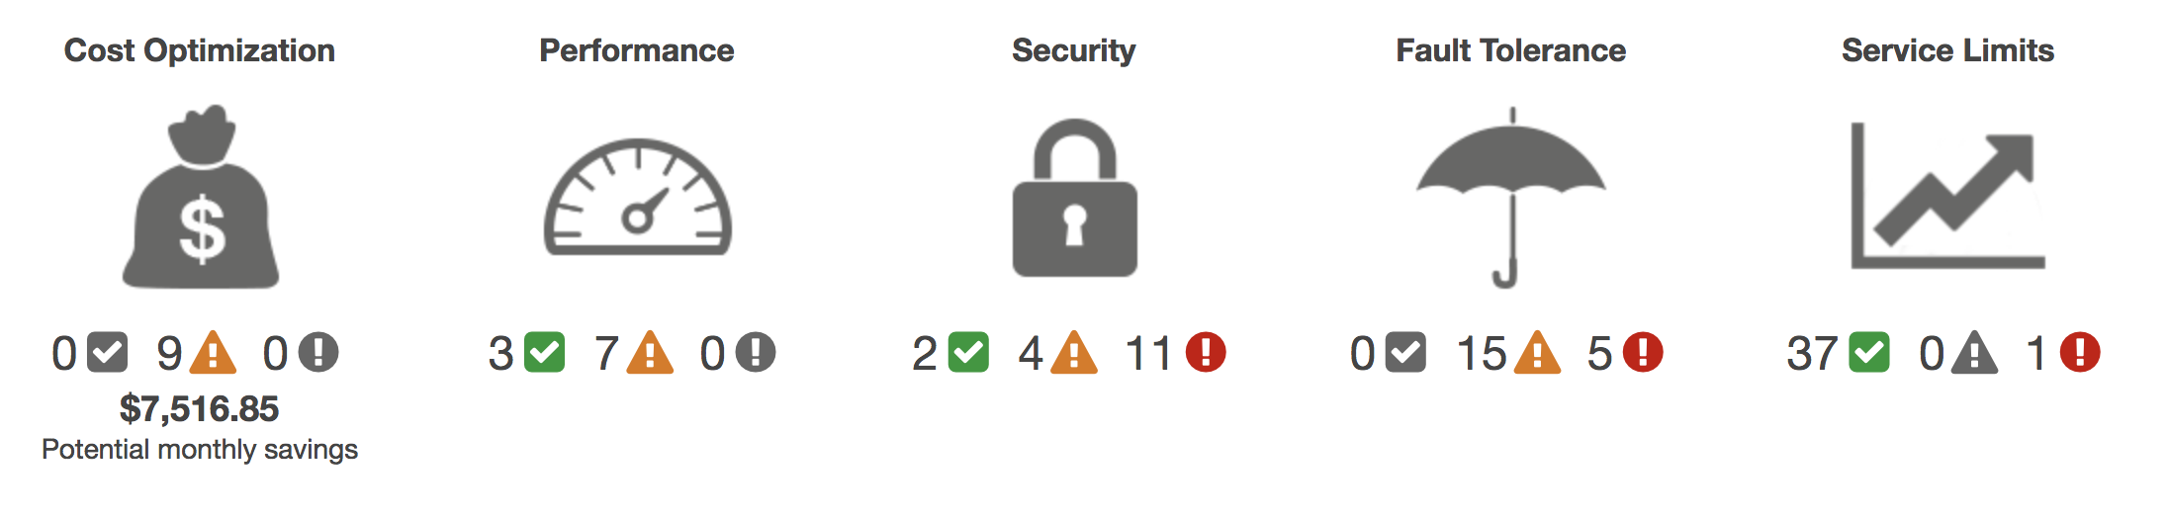
AWS Trusted Advisor
Real-time TA status monitoring…

Slide 66

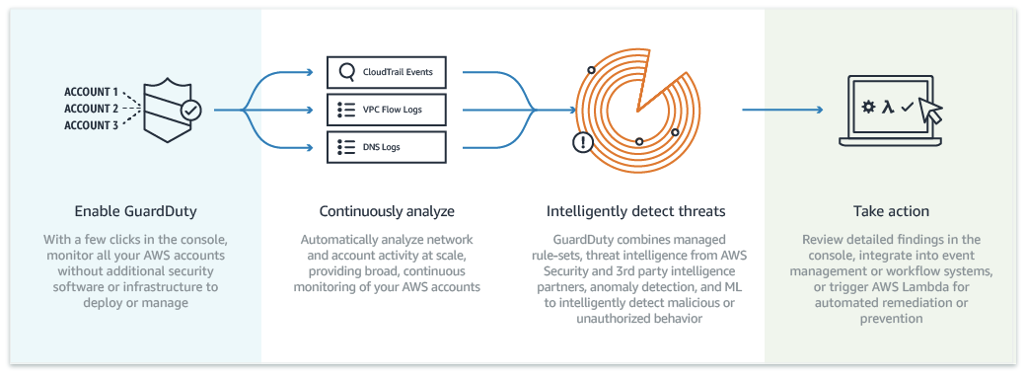
Amazon GuardDuty

Slide 67

Amazon EventBridge
“Serverless event bus to build event-driven apps at scale”
Events can be generated from:
AWS Services (+cross acct, region) – 90+ svcs as sources, 17 as targets
Your Apps
3rd party SaaS sources like Zendesk or Shopify (21+ native SaaS integrations, SaaS events travel AWS network, not pub)

Slide 68
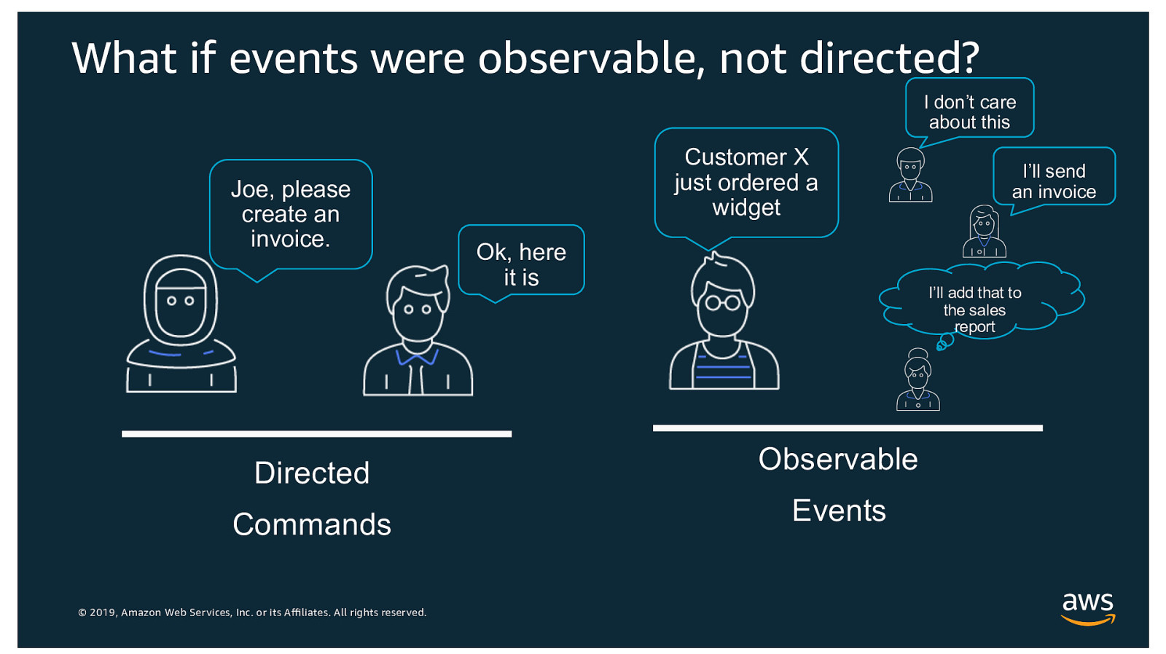
EventBridge: Directed vs Observable
Notes:
AWS “Intro to Amazon EventBridge” https://www.youtube.com/watch?v=TXh5oU_yo9M

Slide 69
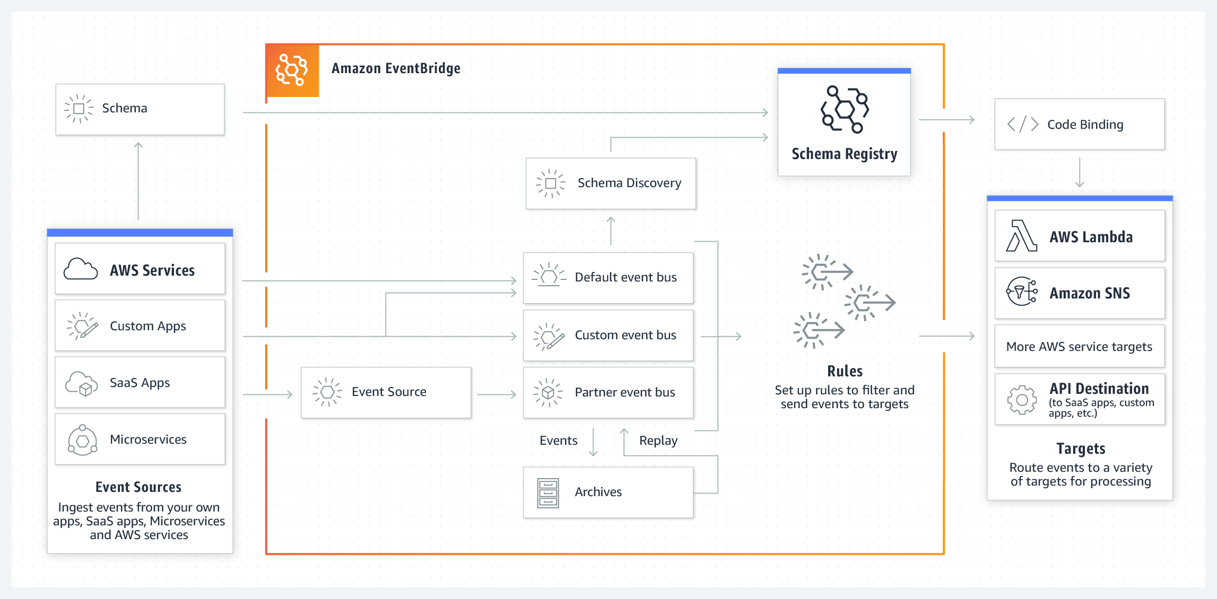
EventBridge Architecture
Notes:
AWS “Intro to Amazon EventBridge” https://www.youtube.com/watch?v=TXh5oU_yo9M

Slide 70
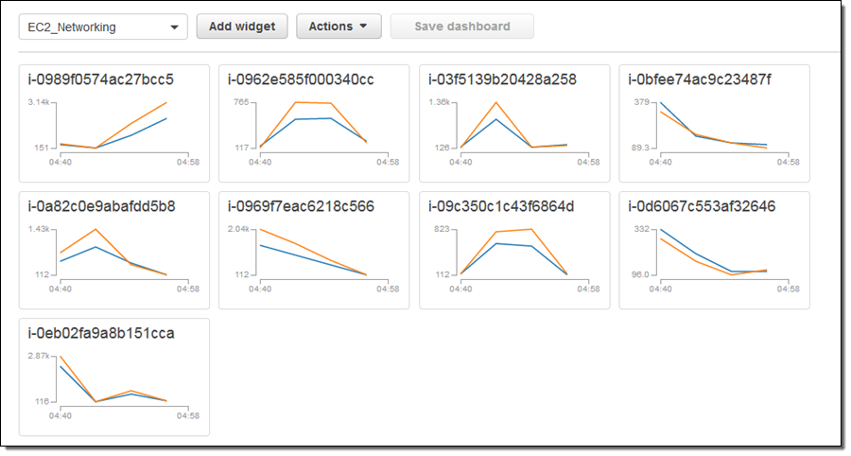
CloudWatch Dashboards
Display graphs & widgets (cross acct & region)
Notes:
CloudWatch dashboard creation tutorial: https://aws.amazon.com/blogs/aws/new-api-cloudformation-support-for-amazon-cloudwatch-dashboards/

Slide 71
Activity 4: Automating GuardDuty and EventBridge alerts to update CloudWatch dashboards
Building a simple CloudWatch Dashboard
Integrating GuardDuty findings into basic CW Dashboard
Updating CW Dashboards with real time EventBridge updates

Slide 72
Course wrap-up and next steps
Evaluations!
Course Slides
Course Code
Want a deeper dive into Lambda automation? Register for Rich’s Advanced AWS Lambda Automation course on May 16, 17, 2022

